Slide 1


Strengthening QA Agencies in the Western Balkans:
Tools, Compliance & Readiness for ENQA –
A Regional Dialogue for Advancing Quality Assurance
Workshop on Self-evaluation
Thursday, April 24 (full day) & Friday, April 25 (half day)
Zagreb, ASHE premises
Tina Šarić, ERI SEE
Notes:
---
Dial by your location
• +1 309 205 3325 US
• +1 312 626 6799 US (Chicago)
• +1 346 248 7799 US (Houston)
• +1 360 209 5623 US
• +1 386 347 5053 US
• +1 408 638 0968 US (San Jose)
• +1 507 473 4847 US
• +1 564 217 2000 US
• +1 646 876 9923 US (New York)
• +1 646 931 3860 US
• +1 669 444 9171 US
• +1 669 900 6833 US (San Jose)
• +1 689 278 1000 US
• +1 719 359 4580 US
• +1 253 205 0468 US
• +1 253 215 8782 US (Tacoma)
• +1 301 715 8592 US (Washington DC)
• +1 305 224 1968 US
Meeting ID: 890 6687 3534
Passcode: 825271
Find your local number: https://us02web.zoom.us/u/kbtO53EkpB

Slide 2

Content
European Standards and Guidelines for Quality Assurance in Higher Education (ESG)
ENQA membership request
Self-Assessment Report (SAR)
Structure of SAR
Group Work and Assignment
Presentation of the Group Work Results

Slide 3
ESG Part 1
PART 1: Standards and guidelines for internal quality assurance
1. Policy for quality assurance
2. Design and approval of programmes
3. Student-centred learning
4. Student admission, progression, recognition and certification
5. Teaching Staff
6. Learning Resources and student support
7. Information Management
8. Public Information
9. On-going monitoring and periodic review of programmes
10. Cyclical external quality assurance

Slide 4
ESG Part 2
PART 2: Standards and guidelines for external quality assurance
Consideration of internal quality assurance
Designing methodologies fit for purpose
Implementing processes
Peer review experts
Criteria for outcomes
Reporting
Complaints and appeals
Notes:
2�1 ConsIderaTIon of InTernal qualITy assuranCe
External quality assurance should address the effectiveness of the internal quality assurance
described in Part 1 of the ESG.
2�2
desIgnIng meThodologIes fIT for purpose
External quality assurance should be defined and designed specifically to ensure its fitness to achieve
the aims and objectives set for it, while taking into account relevant regulations. Stakeholders should
be involved in its design and continuous improvement.
2�3 ImplemenTIng proCesses
External quality assurance processes should be reliable, useful, pre-defined, implemented
consistently and published. They include - a self-assessment or equivalent; - an external assessment normally including a site visit; - a report resulting from the external assessment; - a consistent follow-up.
2�4
peer-revIew experTs
External quality assurance should be carried out by groups of external experts that include (a)
student member(s).
2�5 CrITerIa for ouTComes
Any outcomes or judgements made as the result of external quality assurance should be based on
explicit and published criteria that are applied consistently, irrespective of whether the process leads
to a formal decision.
2�6
reporTIng
Full reports by the experts should be published, clear and accessible to the academic community,
external partners and other interested individuals. If the agency takes any formal decision based on
the reports, the decision should be published together with the report.
2�7 ComplaInTs and appeals
Complaints and appeals processes should be clearly defined as part of the design of external quality
assurance processes and communicated to the institutions.

Slide 5
ESG Part 3
PART 3: Standards and guidelines for quality assurance agencies
Activities, policy and processes for quality assurance
Official status
Independence
Thematic analysis
Resources
Internal quality assurance and professional conduct
Cyclical external review of agencies
Notes:
parT 3: sTandards for qualITy assuranCe agenCIes
3�1
aCTIvITIes, polICy and proCesses for qualITy assuranCe
Agencies should undertake external quality assurance activities as defined in Part 2 of the ESG on a
regular basis. They should have clear and explicit goals and objectives that are part of their publicly
available mission statement. These should translate into the daily work of the agency. Agencies
should ensure the involvement of stakeholders in their governance and work.
3�2
offICIal sTaTus
Agencies should have an established legal basis and should be formally recognised as quality
assurance agencies by competent public authorities.
3�3 IndependenCe
Agencies should be independent and act autonomously. They should have full responsibility for
26
their operations and the outcomes of those operations without third party influence.
3�4
ThemaTIC analysIs
Agencies should regularly publish reports that describe and analyse the general findings of their
external quality assurance activities.
3�5
resourCes
Agencies should have adequate and appropriate resources, both human and financial, to carry out
their work.
3�6 InTernal qualITy assuranCe and professIonal ConduCT
Agencies should have in place processes for internal quality assurance related to defining, assuring
and enhancing the quality and integrity of their activities.
3�7 CyClICal exTernal revIew of agenCIes
Agencies should undergo an external review at least once every five years in order to demonstrate
their compliance with the ESG

Slide 6
ENQA Membership request – Main steps of the ENQA review process
ENQA Agency Reviews are composed of four main elements:
self-assessment,
external evaluation,
external review report, and
follow-up.
The ENQA agency review is initiated by a request from an agency seeking to apply for or renew
ENQA membership.
During the initial phase, ENQA and the agency agree on the terms of reference of the review, including
the activities to be covered in the review as well as the overall timeline.
The first main stage of the review process is the production of the self-assessment report (SAR) by the agency. In order to be accepted and processed by ENQA, the SAR should follow the guide of content provided in these guidelines and cover all indicated elements. (file:///C:/Tina%20One%20Drive/Education%20Reform%20Initiative%20of%20SEE/ERI%20SEE%20-%20Documents/14_Recognition_QA_HE/Academic/01%20Meetings/21%20Workshop%20Zagreb%2024042025/04%20Self-assessment%20Materials/ENQA-Guidelines-2021.pdf )

Slide 7
Self-Assessment Report (SAR)
The preparation of a self-assessment report (SAR) is an essential component of the review process.
It provides the agency with an opportunity to reflect on how it aligns with the ESG and to gather key documentation to support this.
Additionally, the SAR is an opportunity to initiate the discussions on the agency’s current challenges.
As the SAR normally provides a substantial portion of the evidence for the review panel in forming its conclusions, it is important that the report provides clear and comprehensive information, sufficient reflections, critique, and analysis, and that its contents can be corroborated by documentary evidence about the ways in which the agency meets the ESG.
This allows the review panel to achieve a good understanding of the agency in advance of the site visit and enable it to prepare lines of enquiry for the visit.
ENQA expects that the SAR not only states what has been achieved, but also provides a reflection on the practices which could contribute to enhancing the agency’s activities in the future. In other words, the SAR should be both backward and forward facing and should provide an accurate picture of the current situation.

Slide 8
Structure of the Self-Assessment Report
Introduction
Development of the SAR
Higher education and QA of higher education in the context of the agency
History, profile and activities of the agency
Profile, functioning and activities of the agency – compliance with Part 3 of the ESG
5.6 ESG Standard 3.6 Internal quality assurance and professional conduct
6. Desing and Implementation of the agencies EQA – compliance with Part 2 of the ESG)
7. Opinions of stakeholders
8. Recommnedations and main findings from previous reviews
9.SWOT analysis
10. Key challenges and areas for future development
50 – 60 pages, not including annexes
https://view.officeapps.live.com/op/view.aspx?src=https%3A%2F%2Fwww.enqa.eu%2Fwp-content%2Fuploads%2FGuide-of-Content-SAR.docx&wdOrigin=BROWSELINK
Notes:
The self-assessment report should follow the provided main structure (see below). Please delete the indicated instructions before delivering the report to ENQA.
1. Introduction
2. Development of the self-assessment report (SAR)
Describe the means the agency has used to develop and produce the SAR (appointment of a team, involvement of stakeholders, timeline etc.).
3. Higher education and QA of higher education in the context of the agency
Describe the higher education system and the evaluation of higher education in your country/context (as relevant).
4. History, profile and activities of the agency
Describe the history, profile and all activities of the agency (including its quality assurance activities) as well as the agency’s position and status in the national context (where relevant) and its compliance with the national requirements. Make sure to provide information on the agency’s international (cross-border) external QA activities, if applicable. Finally, briefly introduce the agency’s engagement in international activities, to the extent relevant for understanding the agency’s profile (e.g., external relations abroad, membership in international networks, involvement in international projects and how such project work fits the agency’s overall strategy).
The agency’s quality assurances activities should be presented in this chapter in a brief manner, elaborating primarily on the aims and objectives of each activity and how these activities fit the agency’s profile. A more detailed description of quality assurance activities that fall under the ESG is then provided in section 5.1.
5. Profile, functioning and (EQA) activities of the agency (compliance with Part 3 of the ESG)
This chapter addresses the agency’s compliance with each standard of Part 3 of the ESG individually for each different QA activity of the agency. In case the procedure for cross-border QA differs, this should be described here as well. Each sub-chapter concludes with a brief critical reflection on the presented facts.
5.1 ESG Standard 3.1 Activities, policy and processes for quality assurance
Reflect on the requirements of the standard. Clearly define each external QA activity as undertaken by the agency, including the agency’s possible cross-border QA activities. Provide a table that
summarises how many procedures per each EQA activity were implemented per year (for the last five years).
5.2 ESG Standard 3.2 Official status
5.3 ESG Standard 3.3 Independence
Reflect separately on all three aspects of independence as defined in the guidelines of the ESG 3.3: organisational and operational independence and independence of formal outcomes.
5.4 ESG Standard 3.4 Thematic analysis
5.5 ESG Standard 3.5 Resources
Reflect separately on human and financial resources.
5.6 ESG Standard 3.6 Internal quality assurance and professional conduct
5.7 ESG Standard 3.7 Cyclical external review of agencies
6. Design and implementation of the agency’s EQA activities (compliance with Part 2 of he ESG)
This chapter Aaddresses the compliance with each standard of Part 2 of the ESG individually for each different EQA activity of the agency. In case the procedure for cross-border QA differs, please describe it here as well. Each sub-chapter concludes with a brief critical reflection on the presented facts.
6.1 ESG Standard 2.1 Consideration of internal quality assurance
Provide a mapping grid that summarises how each EQA activity meets the standards of Part 1 of the ESG.
6.2 ESG Standard 2.2 Designing methodologies fit for purpose
6.3 ESG Standard 2.3 Implementing processes
6.4 ESG Standard 2.4 Peer-review experts
6.5 ESG Standard 2.5 Criteria for outcomes
6.6 ESG Standard 2.6 Reporting
6.7 ESG Standard 2.7 Complaints and appeals
Reflect separately on complaints and appeals.
7. Opinions of stakeholders
Provide an analysis and critical reflection on stakeholders’ opinions of the agency’s key EQA activities. If an agency already conducts such analysis on a regular basis, a summary of the existing analyses could be used for this section. The results of more substantial analyses can then be added as an annex (e.g., a feedback analysis on the quality and consistency of the agency’s EQA activities in year x).
8. Recommendations and main findings from previous review(s) and agency’s resulting follow-up (for second and subsequent reviews only)
Address the previously made recommendations by the ENQA Board and/or by the review panel and show how the agency has followed-up on them and in a more general approach, provide a short summary of the main findings of the previous review(s) and subsequent actions taken by the agency.
9. SWOT analysis
Analyse the agency’s strengths, weaknesses, opportunities and threats.
10. Key challenges and areas for future development
Glossary of Terms
Annexes
Enclose the most crucial documentation (within reason) you consider may support the analysis of the report, as well as a recent analysis of feedback received from stakeholders and any cases of complaints and appeals, if applicable. These documents can also be provided in footnotes (with links) throughout the self-assessment report

Slide 9
ESG Part 3
PART 3: Standards and guidelines for quality assurance agencies
3.6. Internal quality assurance and professional conduct
Standard:
Agencies should have in place processes for internal quality assurance related to defining, assuring
and enhancing the quality and integrity of their activities.
Guidelines:
Agencies need to be accountable to their stakeholders. Therefore, high professional standards and integrity in the agency’s work are indispensable. The review and improvement of their activities are on-going so as to ensure that their services to institutions and society are optimal. Agencies apply an internal quality assurance policy which is available on its website. This policy:
- ensures that all persons involved in its activities are competent and act professionally and ethically;
- includes internal and external feedback mechanisms that lead to a continuous improvement within the agency;
- guards against intolerance of any kind or discrimination;
- outlines the appropriate communication with the relevant authorities of those jurisdictions where they operate;
- ensures that any activities carried out and material produced by subcontractors are in line with the ESG, if some or all of the elements in its quality assurance activities are subcontracted to other parties;
- allows the agency to establish the status and recognition of the institutions with which it conducts external quality assurance
Notes:
parT 3: sTandards for qualITy assuranCe agenCIes
3�1
aCTIvITIes, polICy and proCesses for qualITy assuranCe
Agencies should undertake external quality assurance activities as defined in Part 2 of the ESG on a
regular basis. They should have clear and explicit goals and objectives that are part of their publicly
available mission statement. These should translate into the daily work of the agency. Agencies
should ensure the involvement of stakeholders in their governance and work.
3�2
offICIal sTaTus
Agencies should have an established legal basis and should be formally recognised as quality
assurance agencies by competent public authorities.
3�3 IndependenCe
Agencies should be independent and act autonomously. They should have full responsibility for
26
their operations and the outcomes of those operations without third party influence.
3�4
ThemaTIC analysIs
Agencies should regularly publish reports that describe and analyse the general findings of their
external quality assurance activities.
3�5
resourCes
Agencies should have adequate and appropriate resources, both human and financial, to carry out
their work.
3�6 InTernal qualITy assuranCe and professIonal ConduCT
Agencies should have in place processes for internal quality assurance related to defining, assuring
and enhancing the quality and integrity of their activities.
3�7 CyClICal exTernal revIew of agenCIes
Agencies should undergo an external review at least once every five years in order to demonstrate
their compliance with the ESG

Slide 10
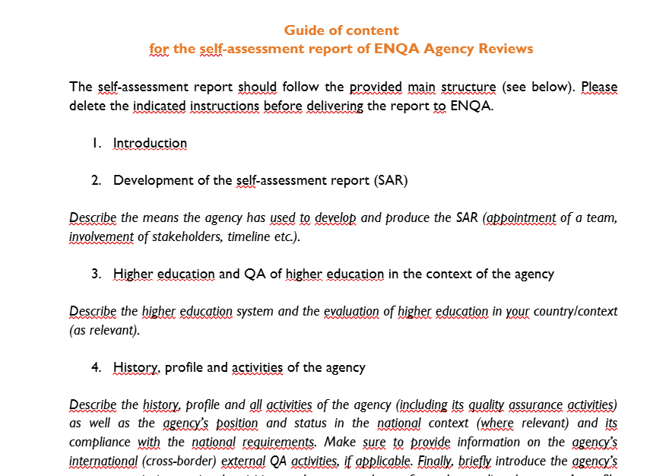
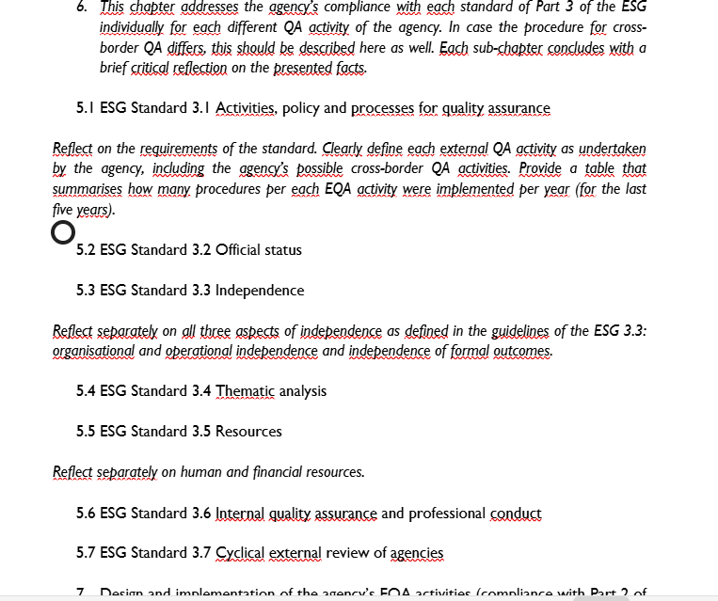

Slide 11
Type of recommendations from reviewers
What to pay attention to:
Strengthen/Formalize internal quality assurance mechanisms (through Quality Policy, Quality Manual, internal QA procedures, etc.), and make them public.
The formalized mechanisms should include plan - do – check – act (PDCA) measures and self-evaluation, through planning – strategic, annual, operational
division of roles and responsibilities, competences, four-eye principle and doble check principle should be clear in the processes
include collecting feedback from committees, HEIs, employees, through surveys, polls etc.; Consider diversifying feedback mechanisms to achieve more qualitative and complex feedback that would better facilitate further improvements
ensure analyzing data and planning improvements
Appoint individuals for dignity of employees, informing the public, units for Internal quality
Develop a plan for the digitalization of evaluation procedures (e.g. a digital platform to support external quality assurance procedures, digitalization of documentation and outcomes, a digital database of reviewers and evaluation of reviewers by coordinators, digital modules for experts’ training, etc.)
Develop systematic approaches to the internal QA of the agency and to implement them in a structured and systematic way
Notes:
elements of quality assurance activities are subcontracted to other parties, and allow the agency to determine and confirm the status and recognition of higher education institutions with which it conducts external quality assurance procedures.
Appoint individuals within the agency responsible for preserving the dignity of employees and for informing the public.
Develop regular, timely surveys to be directed to all involved stakeholders after the conclusion of every procedure conducted by AQHE, and the results to be analysed and used for the further development of AQHE’s activities.

Slide 12
Workshop on Self-evaluation Report
1. Division in groups:
AL – XK
BA – MK
RS – ME
2. Agreement on the standard:
ESG Standard 3.6 Internal quality assurance and professional conduct
(Chapter 5 of the SAR, subchapter 5.6.)
3. Analysis of the requirements of the SAR (from ESG and Guidelines for SAR)
https://view.officeapps.live.com/op/view.aspx?src=https%3A%2F%2Fwww.enqa.eu%2Fwp-content%2Fuploads%2FGuide-of-Content-SAR.docx&wdOrigin=BROWSELINK
4. Peer learning – working in groups, discussing the particular chapter – how to structure it, what to include as information, what to include as additional materials, what are the challenges, plans etc.
5. Drafting the chapter (each agency on its own)

Slide 13
Presentation of results
Plenary presentation of results (description of the chapter, challenges, plans etc.)
Conclusions – what needs to be done, what are the next steps

Slide 14
Peer learning, discussion, drafting of the chapter
Exchange of practices that exist in the agencies regarding the standard 3.6.
Exchange of information about documents that corraborate the standard
Challenges, plans for the future
Drafting of the chapter

Slide 15

email: office@erisee.org
Education Reform Initiative of South Eastern Europe/ERI SEE Secretariat
Dečanska 8a
11000 Belgrade
Tel: +381 (0)11 3345 376
Fax: +381 (0)11 3345 378
www.erisee.org
Thank you!

Slide 16
ESG Part 3
PART 3: Standards and guidelines for quality assurance agencies
Activities, policy and processes for quality assurance
STANDARD:
Agencies should undertake external quality assurance activities as defined in Part 2 of the ESG on a regular basis. They should have clear and explicit goals and objectives that are part of their publicly available mission statement. These should translate into the daily work of the agency. Agencies should ensure the involvement of stakeholders in their governance and work.
Guidelines
To ensure the meaningfulness of external quality assurance, it is important that institutions and the public trust agencies.
Therefore, the goals and objectives of the quality assurance activities are described and published along with the nature of interaction between the agencies and relevant stakeholders in higher education, especially the higher education institutions, and the scope of the agencies’ work. The expertise in the agency may be increased by including international members in agency committees.
A variety of external quality assurance activities are carried out by agencies to achieve different objectives. Among them are evaluation, review, audit, assessment, accreditation or other similar activities at programme or institutional level that may be carried out differently. When the agencies also carry out other activities, a clear distinction between external quality assurance and their other fields of work is needed.
Notes:
parT 3: sTandards for qualITy assuranCe agenCIes
3�1
aCTIvITIes, polICy and proCesses for qualITy assuranCe
Agencies should undertake external quality assurance activities as defined in Part 2 of the ESG on a
regular basis. They should have clear and explicit goals and objectives that are part of their publicly
available mission statement. These should translate into the daily work of the agency. Agencies
should ensure the involvement of stakeholders in their governance and work.
3�2
offICIal sTaTus
Agencies should have an established legal basis and should be formally recognised as quality
assurance agencies by competent public authorities.
3�3 IndependenCe
Agencies should be independent and act autonomously. They should have full responsibility for
26
their operations and the outcomes of those operations without third party influence.
3�4
ThemaTIC analysIs
Agencies should regularly publish reports that describe and analyse the general findings of their
external quality assurance activities.
3�5
resourCes
Agencies should have adequate and appropriate resources, both human and financial, to carry out
their work.
3�6 InTernal qualITy assuranCe and professIonal ConduCT
Agencies should have in place processes for internal quality assurance related to defining, assuring
and enhancing the quality and integrity of their activities.
3�7 CyClICal exTernal revIew of agenCIes
Agencies should undergo an external review at least once every five years in order to demonstrate
their compliance with the ESG

Slide 17





Higher Education
Cooperation with Regional Cooperation Council (RCC)
Focus on recognition of higher education qualifications and quality assurance systems
Activities:
  Study visit for QA agencies on the integration of the ESG standards into regular work of QA agencies
  Founding meeting of the Joint Commission for the Implementation of the Agreement on recognition of higher education qualifications in the WB6 (Joint Commission WB6)
  Skoplje, North Macedonia, 26th September: International conference on quality

Slide 18


