Slide 1

HCD and Quality Assurance
“Common Regional Market as a catalyst for deeper regional economic integration in the WB6 and a stepping stone towards EU single market"

Slide 2

RCC Mandate: connecting the dots in the region, enabling unobstructed information flow and facilitating alliances that enable more synchronised operations on the ground.
1
Political
2
Not donor organization
3
Operative arm of SEECP
4
All-inclusive

Slide 3
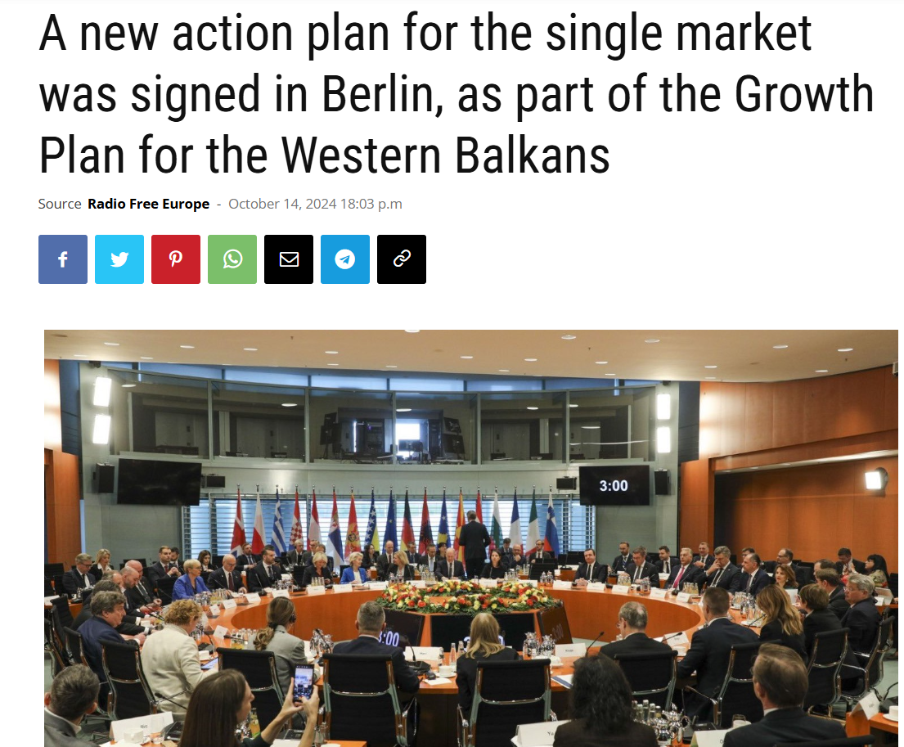
RCC’s convening power remains key in fostering regional cooperation.
Connection to Growth Plan Structure: Pillar I: Reform Agenda; Pillar II: Regional Cooperation.
CRM – Key Achievements (2020–2024)
CRM 2.0 Expected results
(2025-2028)
✅ 50+ measures implemented✅ 500% increase in WB6 roaming use✅ Lower EU–WB6 roaming costs✅ 23% of businesses seek WB6 labor✅ WB6 intra-regional trade doubled✅ 3% GDP per capita growth (2017–2022)✅ Degrees & 7 professions recognized✅ 20 years saved via Green Lanes📊 82% public support for regional cooperation (BB 2024)
✅ Stronger alignment with EU Single Market✅ Backed by the €6B Reform & Growth Facility (2024–2027)🎯 Expected Outcomes by 2025:📈 +1.3% GDP via labor mobility🌍 +2% annual economic growth💰 +6.5% investment👷 +1% annual job growth🚀 +5–10% increase in SME productivity

Slide 4

Enhancing employability through skills development initiatives
Addressing the Skills Gap for a Competitive Workforce
Supporting Mobility and Alignment with EU Standards for Professionals
Identifying and closing the skills gap is essential to meet labor market demands and enhance employability across the Western Balkans Six.
Ensuring that qualifications are recognized across the WB6, enhancing mobility and employment opportunities.
Fostering Regional Partnerships for Educational Recognition and Quality Assurance
Strengthening Social Protection Frameworks
Collaborating with European networks to strengthen educational recognition and integrate quality assurance systems.
Ensuring portability of social rights and establishing continuous dialogue on social security reforms is crucial for worker protection in the region.

Slide 5
Human Capital Development Component
1
(4.1. )Standards in education and quality assurance
2
(4.2.) Close the skills gap
3
(4.3.) Labour market reform for economic opportunities.
4
(4.4.) Boost Regional Innovation

Slide 6
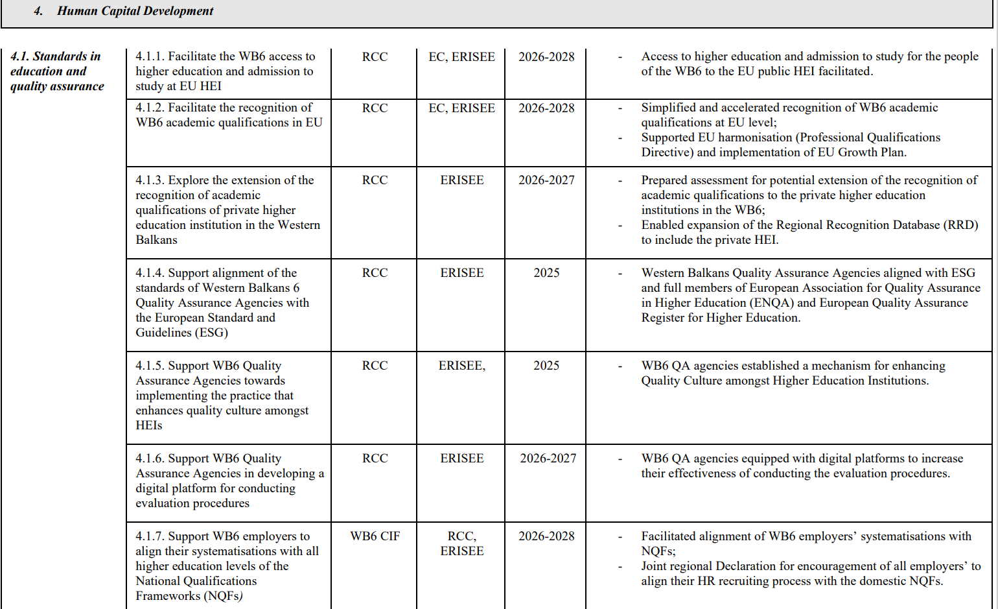
Human Capital Development / Quality Assurance Measures

Slide 7
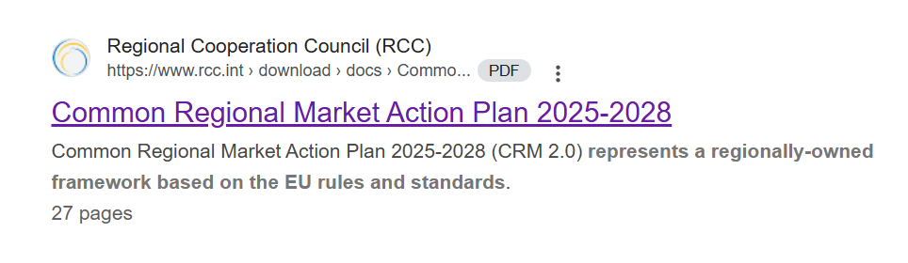


HCD Measures elaborated
Facilitate access to higher education and study admission for students from WB6 in EU public higher education institutions (HEIs).
Ensure WB6 students have unrestricted access to study and admission opportunities within the WB6.
Accelerate recognition of WB6 academic qualifications at the EU level.
4.1
Enable portability of social rights.
Agreement on relaxation of work permit procedure within the WB6.
Adopt a regional declaration for vocational education and training (VET).
Create three common regional bases for occupational standards for VET in the WB6.
Eliminate unnecessary licensing and harmonise licensing requirements for occupations that will remain under the licensing system.
Develop unified regional STEM education policies and guidelines at all educational levels.
4.2
4.3
Prepare the WB6 for alignment with EU social security standards by facilitating agreements on social security system.
Establish a Regional Social Security Network.
Explore opportunities to align pension-related matters across the region, where feasible.
Discuss the portability and equal treatment of pension benefits.

Slide 8

Promoting professional mobility aligned with EU standards
Agreement on Recognition of Professional Qualifications for Doctors of Medicine, Dentists and Architects
Agreement on Recognition of Professional Qualifications for Nurses, Midwives, Veterinary Surgeons and Pharmacists
Agreement on Freedom of Movement with ID
Agreement on Recognition of Higher Education Qualifications
Agreement on Access to Higher Education and Admission to Study in the Western Balkans

Slide 9





HCD as a centerpiece of CRM 2.0
Green principles mainstreamed through CRM2
Business Enabling
Environment
Digital transformation and connectivity

Slide 10
RCC – 2025 Support & Regional Initiatives
RCC Support
✅ Ongoing monitoring role (incl. second ESG mock review)
✅ Expertise support for North Macedonia AQHE (to be formally communicated)
2. Regional Meetings on current Mobility Agreements
3. STEM Education
📌 Joint WB6 Leaders' statement on STEM
4. Recognition Mechanisms
🧩 Expand RRD to online tool for professional qualification recognition
Updates: State of Play regarding the implementation of the Regional Recognition Database (RRD).

Slide 11

Thank you!
Regional Cooperation Secretariat
Trg Bosne i Hercegovine 1/V
71000 Sarajevo, Bosnia and Herzegovina
Tel: +387 33 561 700
Mob: +387 61 190 601
www:rcc.int
Twitter:@rcccint
Instagram: @regionalcooperationcouncil_rcc
Facebook:RegionalCooperationCouncil
YouTube:RCCSec
LinkedIn: Regional Cooperation Council (RCC)

