Slide 1



ASHE and ESG
Quality assurance procedures
A Regional Dialogue for Advancing Quality Assurance
Sector of Quality Assurance in Higher Education and Research
Marina Grubišić and Mia Đikić

Slide 2
Content
Agency for Science and Higher Education
Overview of ASHE’s evaluation procedures
Compliance of procedures with ESG standards
Involvement of stakeholders
Peer-review experts and training module for experts

Slide 3
Agency for Science and Higher Education

Slide 4
Agency for Science and Higher Education
2005 – founding of ASHE
2011 – membership in ENQA / EQAR
2017 and 2022 – ENQA membership renewal
2022 – new Law on Quality Assurance in Higher Education and Science
ASHE is internationally active and is a member of many international associations such as ECA, CHEA, CEENQA and others

Slide 5
Agency for Science and Higher Education
Accreditation Council
Complaints Committee
Follow-up Committee
The work of all bodies includes the participation of different stakeholders, including students

Slide 6
Overview of ASHE’s Evaluation Procedures

Slide 7
Overview of ASHE’s Evaluation Procedures
Initial accreditation
Reaccreditation
Thematic accreditation
One-off evaluation
Cross-border evaluation
Accreditation of the joint study program between domestic and foreign HEI – European Approach

Slide 8
Initial accreditation
Initial accreditation of higher education institutions and research institutes
Initial accreditation of new study programme or changes to the program as prescribed by law regulative (change of program provider, location of delivery, language etc.)
Special procedures for doctoral studies and online studies.

Slide 9
Reaccreditation
Reaccreditation of higher education institutions or research institutes
Periodic procedure (every five years)
In accordance with the previous legal regulations, a reaccreditation procedure for all doctoral studies in Croatia was carried out

Slide 10
Thematic and one-off evaluation; cross-border
Thematic evaluation focuses on a particular topic and does not result in a formal outcome
One-off evaluation refers to one or more areas of activity of a higher education institution or a scientific institute
Purpose: To address particular issues, promote best practices, and inform policy decisions.
Cross-border evaluation of higher education institutions and evaluation of research institutes

Slide 11
European Approach to joint study program
Higher education institutions participating in the implementation of joint programmes jointly select an agency (must be registered in EQAR) to conduct the evaluation process
ASHE carries out accreditation in accordance with the European approach to quality assurance in joint studies
ASHE, based on the positive outcome of another EQAR-registered agency, also issues a licence

Slide 12
Evaluation procedures
Peer-review (at least 5 expert panel members)
Quantitative and qualitative data (Self-evaluation document)
Site visit
Report
Comment on the Report
Accreditation Council
Follow-up procedure

Slide 13
Compliance of procedures with ESG standards

Slide 14
ESG – Standards and Guidelines for QA in the EHEA
Part I: Internal Quality Assurance
Part II:
External Quality Assurance
Part III:
Quality Assurance Agencies

Slide 15
Quality Assurance
Internal QA
It is implemented by institution itself
Does not include external expert panel
External QA
It is implemented by external independent body (QA agency)
Includes external expert panel

Slide 16
ESG II: Standards and Guidelines for External QA
2.1 Consideration of internal quality assurance
2.2 Designing methodologies fit for purpose
2.3 Implementing processes
2.4 Peer-review experts
2.5 Criteria for outcomes
2.6 Reporting
2.7 Complaints and appeals

Slide 17
2.1 Consideration of internal quality assurance
External quality assurance should address the effectiveness of the internal quality assurance processes described in Part 1 of the ESG.
1.1 Policy for quality assurance
1.2 Design and approval of programmes
1.3 Student-centred learning, teaching and assessment
1.4 Student admission, progression, recognition and certification
1.5 Teaching staff
1.6 Learning resources and student support
1.7 Information management
1.8 Public information
1.9 On-going monitoring and periodic review of programmes
1.10 Cyclical external quality assurance

Slide 18
Compliance of ASHE procedures with ESG standards
1. Higher education institution management and quality assurance (ESG 1.1, ESG 1.7 and ESG 1.8)
2. Study programmes and lifelong learning programmes (ESG 1.2 and ESG 1.9)
3. Student-centred learning and teaching – the teaching process and student support (ESG 1.3, ESG 1.4 and ESG 1.6)
4. Teaching capacities and infrastructure of the higher education institution (ESG 1.5 and ESG 1.6)

Slide 19
Standards in ASHE’s procedures
Standard (clearly defined level of quality), criteria (prescribed by law), elements and indicators (are used to asses level of compliance with standards), sources (examples that can be used as quidelines)
The quality standards are divided into assessment areas
Ex. Initial accreditation (doctoral s.p.):
I Internal QA
II Study programme
III Teaching process and student support
IV Teaching and supervisior resources and infrastructure

Slide 20
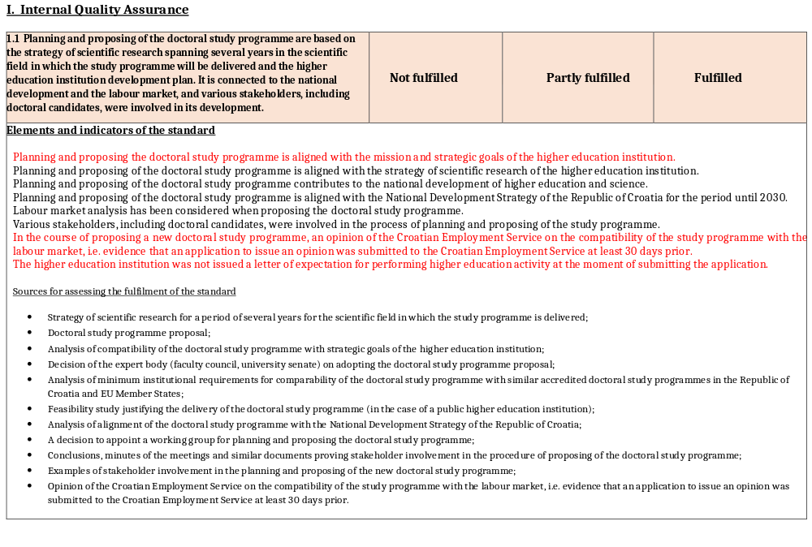
Standards in ASHE’s procedures

Slide 21
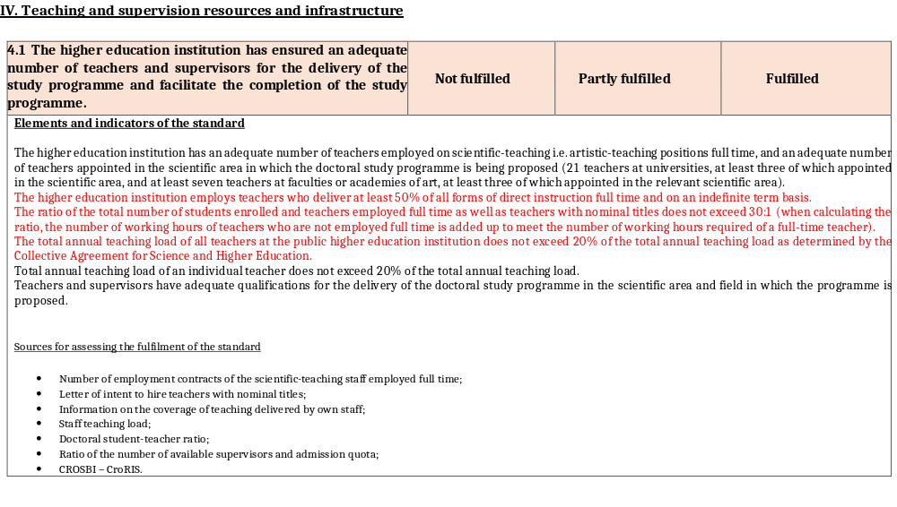
Standards in ASHE’s procedures

Slide 22
Involvement of stakeholders

Slide 23
Involvement of stakeholders
Forms of stakeholder involvement:
Representation in QA committees - Accreditation Council, Follow-up Committee, Complaints Committee and governance - Management Board
All key documents and procedures related to quality assurance are subject to public consultation before final adoption
Providing feedback through surveys and focus groups
Serving on quality assurance panel members
Engaging in external evaluation processes at their institution

Slide 24
How to enhance Stakeholder Participation
Clear communication and transparency
Stakeholder involvement is not a one-time event, but a continuous process
Participation in bodies ensures that quality assurance is not top-down but a shared responsibility
Conferences, workshops, webinars

Slide 25
Workshops for HEIs
At the beginning of each accreditation cycle for all HEIs (informing about changes/updated documents)
Annual workshops for HEIs included in the accreditation plan for the next year
This year we will have 2 workshops
First in December for HEIs who are having site visit in spring
Second in May for HEIs who are having site visit in autumn
-general information about accreditation
-self-assessment process
-accreditation standards, indicators, evidences
-IT system for collecting the data – additional workshop
-accreditation procedure

Slide 26
Conferences, webinars on different topics
Topics related to ESG I
Series of workshops on topics identified as a challenge in accreditation
- development of study programmes based on LO and CroQF
- student centred learning, new teaching approaches
- student assessment
- strengthening internationalization
Actual topics and trends
- joint programmes, European universities…

Slide 27
Peer-review experts and training

Slide 28
Open call for panel members
Open call for researchers, teachers at a higher education institutions and students to participate as members of expert panels in the external evaluation procedures
Published on our website and the websites of partner agencies
Direct invitation to student union and associations

Slide 29
Expert panel composition
2-3
2-3
1
National experts
University (college) professors
International experts
University (college)
professors
tSStudent member

Slide 30
Involving students in external QA
Mandatory members of expert panels in accreditation procedures with the same obligations and rights as other members (the same duties and fees)
Participate the same training together with other panel members (online and onsite)
Student member chairing the meeting with students and actively participates/asking questions at other meetings

Slide 31
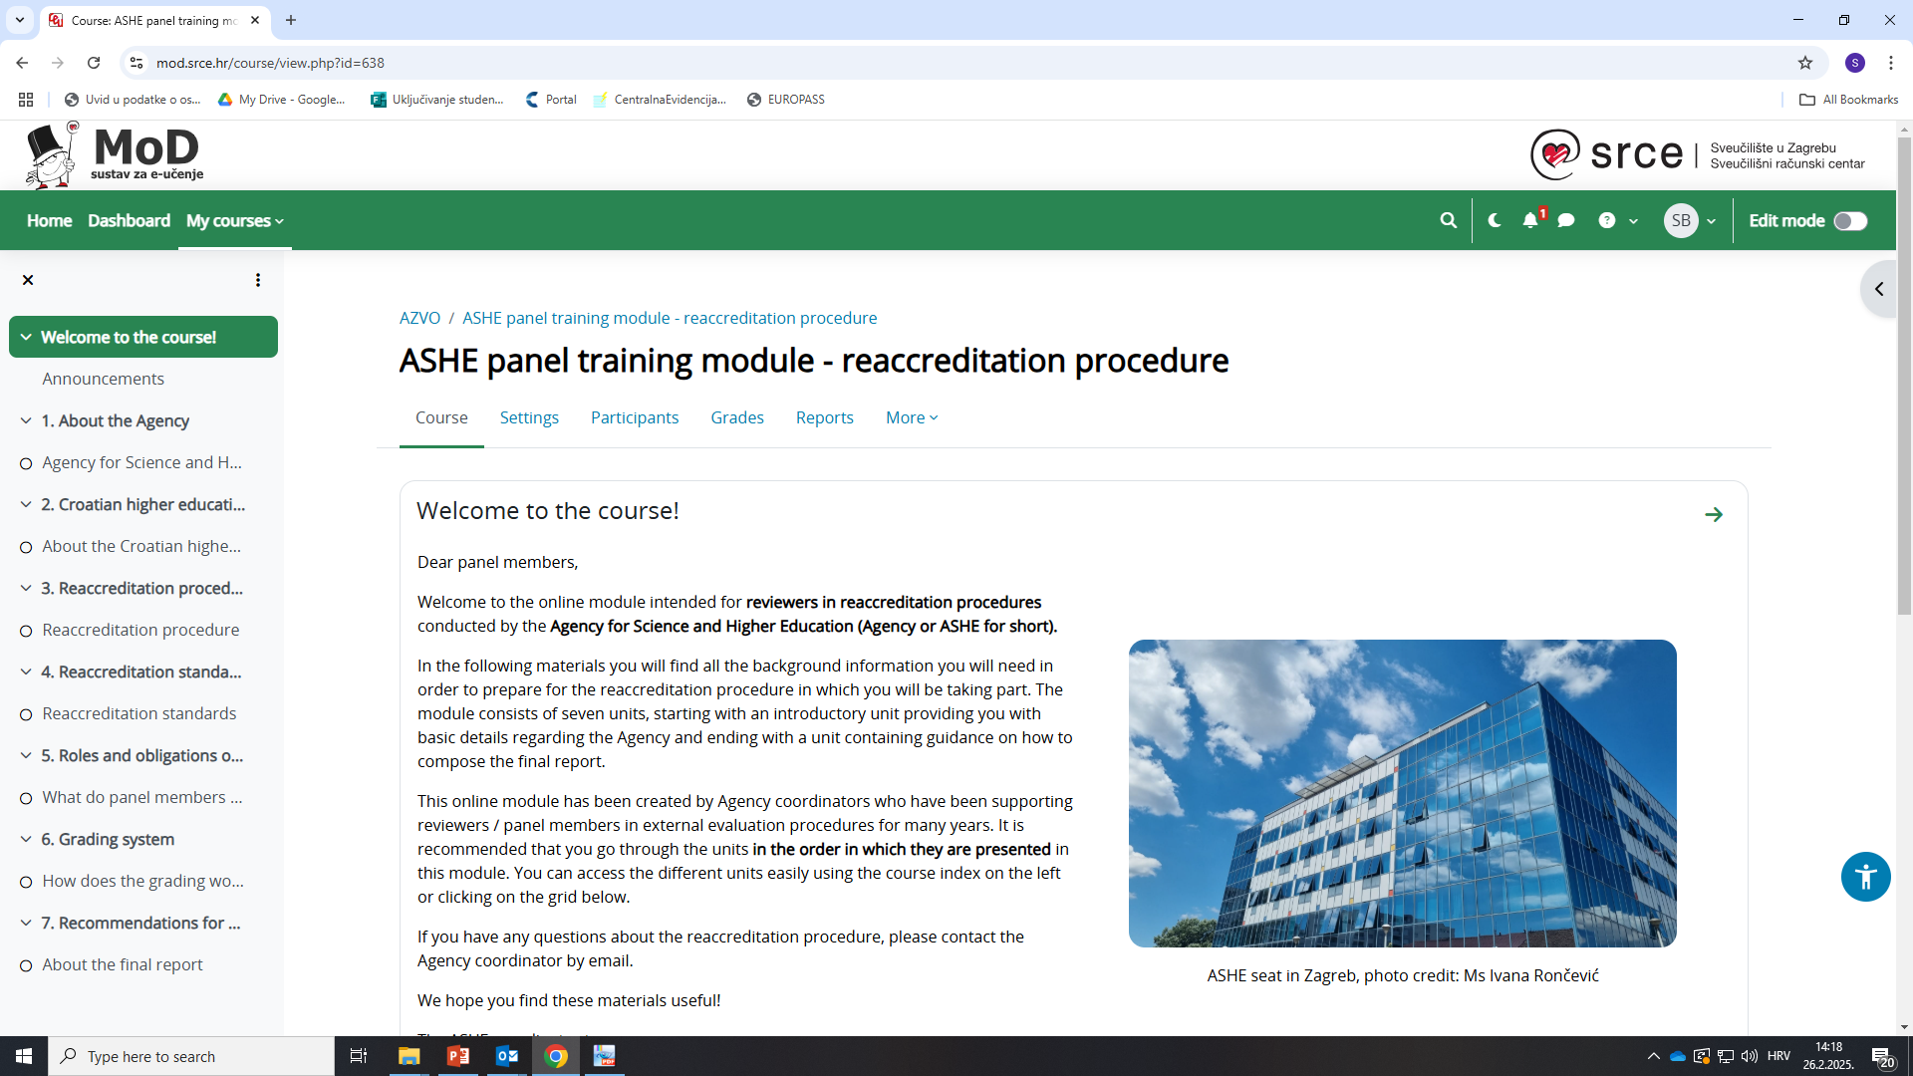
Online training

Slide 32
Online training 2
Topics
  Legislative framework and ASHE documentation for conducting accreditation
  HE system in Croatia and its specificities
  Procedure of accreditation
  Accreditation standards
  Assessment against standards
  Writing the final report
  Roles and obligations of panel members and panel chair

Slide 33
Thank you for your attention! marina.grubisic@azvo.hr mia.dikic@azvo.hr

