Slide 1
Implementing QA in Complex Organisations
Applications of Theory to Educational QA
Anthony F. Camilleri – CROQANET Workshop, Zagreb, 20-12-2018

Slide 2
Context of QA
in Higher Education

Slide 3
Stages of Quality Assurance
Immediate
While the process is ongoing
Detect and correct errors
Short-Term
Immediately after end of process
Evaluate overall efficiency of process
Long-Term
A set period after end of the process
Evaluate overall effectiveness of process
?
focus of most IQA

Slide 4
The bureaucratic model of QA
Plan
Do
Check
Act
create an
implementation
plan
organise a
meeting
conduct a
survey
run a pilot

Slide 5

Result of QA?

Slide 6
Higher Education Institutions are autonomous by design
autonomous in its administration, and in its staff selection
autonomous in what it chooses to teach, and how to teach it
autonomous in its decisions on how to include research in the curriculum
autonomous in its research programme
autonomous in its selection of students
autonomous in decisions on recognising and valuing credentials issued by other institutions

Slide 7
Autonomy is Expressed at every level of education
Autonomy of Higher Education Sector
01
Autonomy of Individual Institutions
02
Autonomy of Researchers & Academics
03

Slide 8


Slide 9
Magna Carta Universitatum
First signed in 1987 on the 900th anniversary of the university of Bologna
Considered to be the intellectual origin of the Bologna Process, and hence of all credential recognition and transfer in Europe
Has now been signed by 816 Universities from 86 countries

Slide 10
Autonomy
“The university is an autonomous institution at the heart of societies…
…its research and teaching must be morally and intellectual independent of all political authority and economic power…
…freedom in research and training is the fundamental principle of university life, and governments…must ensure respect for the fundamental requirement”
Magna Carta Universitatum

Slide 11
Autonomy can translate into resistance
Quality
Control
Assurance
Culture
Review
Autonomy

Slide 12
Stages of Quality Assurance
Immediate
While the process is ongoing
Detect and correct errors
Short-Term
Immediately after end of process
Evaluate overall efficiency of process
Long-Term
A set period after end of the process
Evaluate overall effectiveness of process

Slide 13
Kaizen
as a philosophy for IQA

Slide 14
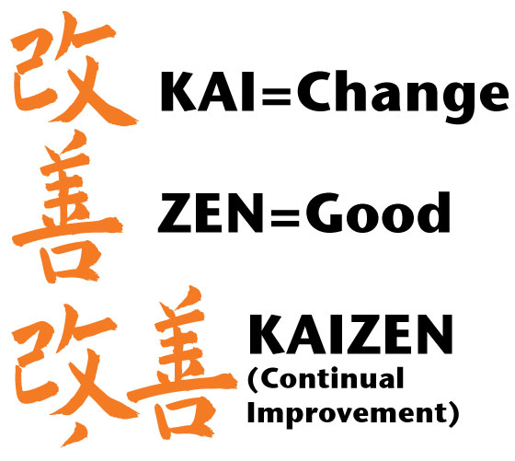

Slide 15
Why Kaizen?
“Every Toyota team member is empowered with the ability to improve their work environment. This includes everything from quality and safety to the environment and productivity. Improvements and suggestions by team members are the cornerstone of Toyota’s success”
Masaaki Imai

Slide 16
Under Kaizen
Improvements in processes are based on many small changes rather than radical policy shifts
Ideas for improvement come from the staff actually working on the activities, not from management or consultants
All staff should continually be seeking ways to improve their own performance
All staff take ownership over and responsibility for their work

Slide 17
Integrating Kaizen in Daily Work
Management
mandates regular kaizen events
provides leeway for implementation and testing
Teams
Hold regular kaizen events
(stand-alone or as part of other events)
Individuals
Highlight problems
Propose Ideas
flow of
ideas

Slide 18
Kaizen requirements
Input from teams working
towards a Common Goal
Students | Teachers | Managers
reaching a group grade | meeting a faculty target | achieving an institutional objective

Slide 19
any team can do Kaizen
including students

Slide 20
Kaizen requirements
Support from Management
give teams authority to make change
willingness to experiment (and fail)
budget

Slide 21
Identify
Test
Monitor
Discuss
Share
Mainstream
Six Steps
to Kaizen

Slide 22
Identify
Test
Monitor
Discuss
Share
Mainstream
Ask for problems linked to:
waste
low efficiency
low quality
stale ideas

Slide 23
Identify
Test
Monitor
Discuss
Share
Mainstream
Check with the team:
do you share the issue
how can we resolve the issue together
Ideas should be
implemented
now by the team

Slide 24
Identify
Test
Monitor
Discuss
Share
Mainstream
Document the improvement
Define a measurable success factor
Try it out

Slide 25
Identify
Test
Monitor
Discuss
Share
Mainstream
While trying out the improvement, check to see if its working, using the indicator

Slide 26
Identify
Test
Monitor
Discuss
Share
Mainstream
Share your results:
with the team
with other teams
with the management
at your next meeting
(or at the water cooler)

Slide 27
Identify
Test
Monitor
Discuss
Share
Mainstream
Adopt the improvement for the entire team, and have management integrate into the management system.

Slide 28
DOCUMENT
every step
(concisely)

Slide 29
Meeting Expectations
using Quality
Assurance

Slide 30
Role of Quality Assurance
determine requirements
IQA supports continual improvement
Students
World of Work
Institutional policies reflect requirements
Institutional activities implement mission
Government
verifies
checks
External Quality Audit

Slide 31
How to:
detect requirements of every student?
assess the requirements of every student?
effectively meet those requirements
keep a management overview of these activities
continually improve your activities to correct and errors and anticipate future requirements

Slide 32
Unmet Student Requirement
=
ERROR

Slide 33
Potential Data Sources
surveys
workshops
graduate tracer studies
quality assurance questionnaires
complaints
word-of-mouth
Your Role
to facilitate these interactions
to collect this data yourselves and compare

Slide 34
How to determine student requirements?
what do you want?
what do you want?
students
help your institutions

Slide 35
A Different Idea
to learn the requirements of every student
ASK THEM

Slide 36
Issue Management
A system whereby:
  each student indicates their needs using a standard form
  each of those needs is formally addressed by teachers / management

Slide 37
Types of
Issues
Requests
Suggestions for Improvement
Compliments
Complaints

Slide 38
Types of
Address
immediate resolution
  we will fix this by the next lesson
later resolution
  we will address this later in the course
deferred resolution
  we will consider this for the next round
escalated
  sent to management
noted
  the has been taken aboard, but no direct action results
ignored
  we disagree that this needs resolution, so we have closed it

Slide 39
Issue Management for Education
Create Portal
space where students can register issues at any time
Systemise Issue Creation
Provide Feedback
lecturer / teacher should address every issue
issues should be created at the end of every lesson
as well as at any other time

Slide 40

Student View
What should we do to
improve your learning?

Slide 41
Types of feedback
These are all require the same action…
an individual response by the responsible person
“explain modal verbs better”
“spend more time on conversation”
“I’m tired from studying too much”
“Teacher is asking for bribes”
“Curriculum is/isn’t relevant for my future job”
“I didn’t understand slide 17…”

Slide 42
Teacher View
Issue # | Issue | Category | Action | Resolution
1 | Don’t understand past participle | Course comment | Please explain at next lesson | Immediate resolution
2 | This diagram is cool | Course comment | None | Noted
3 | Classroom is not well-lit | Infrastructure | Improve lighting | Escalate
4 | Double lessons are too long | Course comment | Change timetable | Deferred

Slide 43
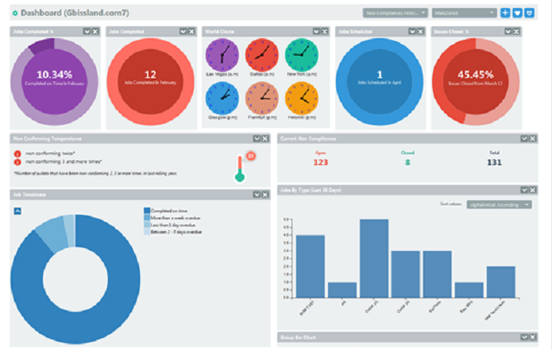
Management View

Slide 44
Don’t forget Changelogs!
Standard Slide in Every Meeting / Lecture
list feedback received
and how it is being addressed

Slide 45
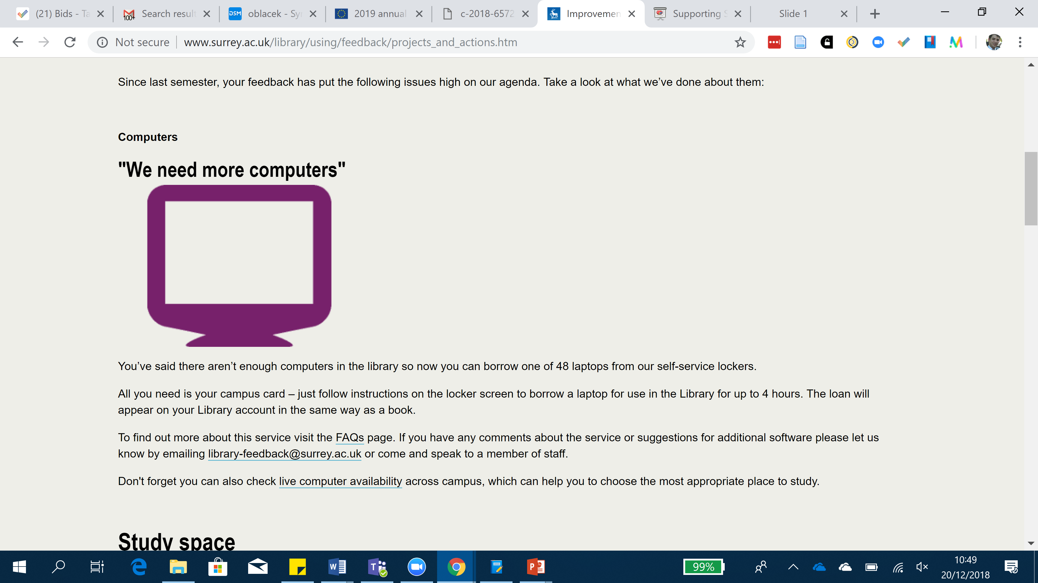
Don’t forget Changelogs!

Slide 46
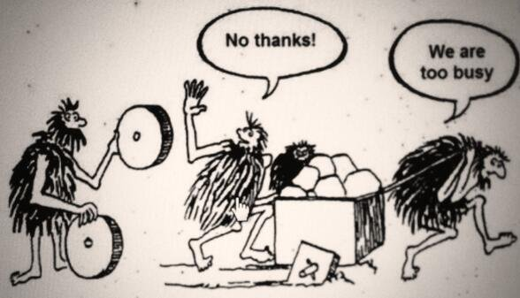
Well implemented QA

Slide 47



Thanks for your
attention
Presentation available from
http://www.slideshare.net/anthonycamilleri
anthony@knowledgeinnovation.eu
Released under a Creative Commons Attribution ShareAlike 4.0 International License
You are free:
to Share — copy and redistribute the material in any medium or format
to Remix — remix, transform, and build upon the material
for any purpose, even commercially.
Under the following conditions:
Attribution — You must give appropriate credit, provide a link to the license, and indicate if changes were made. You may do so in any reasonable manner, but not in any way that suggests the licensor endorses you or your use.
Share Alike — If you remix, transform, or build upon the material, you must distribute your contributions under the same license as the original..

