Slide 1




Institutional research –
External Quality Assurance
Dr. sc. Vesna Dodiković-Jurković
Rijeka, February 2016

Slide 2
Summary
EHEA
ESG and QA activities
Impact and future challenges

Slide 3
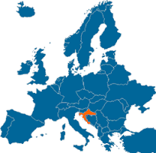
EHEA
Inclusive EHEA
Common action
Calls for more evidence-based policies
Croatian HE system
ESG

Slide 4
ESG – Purposes
They set a common framework for QA systems for learning and teaching at European, national and institutional level
They enable the assurance and improvement of quality of higher education in EHEA
They support mutual trust, thus facilitating recognition and mobility within and across national borders
They provide information on quality assurance in EHEA.

Slide 5
ESG – basic principles
HEIs have the primary responsibility for the quality of their provision and its assurance
Quality assurance responds to the diversity of higher education systems, institutions, programmes and students
Quality assurance supports the development of quality culture
Quality assurance takes into account needs and expectations of studenats, all other stakeholders and society.

Slide 6



Croatian QA Agency (ASHE) – externally evaluated
2005 – ASHE establishment and beginning of development of QA model in line with the Standards and Guidelines for QA in the European Higher Education Area (ESG) using best international practices
2011 – externally evaluated – ENQA/EQAR membership/full compliance with ESG
INQAAHE full membership

Slide 7
Activities
Quality assurance activities in HE and science
2. Collecting and analyzing data on the systems of science and higher education
3. National ENIC/NARIC Office
4. Central Applications Office
5. Support to various national bodies
6. International cooperation

Slide 8
QA role
1
Initial accreditation
new HEIs and/or new study programmes
new scientific organizations established and/or financed by state
scope: fulfillment of minimal criteria is checked
2
Re-accreditation
mandatory for all public and private HEIs in five-years cycles (first cycle by 2015)
mandatory for all scientific organizations established and/or financed by state (by 2015)
scope: quality assurance (accountability) and quality improvement (enhancement)
3
Audit
voluntary for all HEIs
scope: degree of development and efficiency of the internal QA system of HEIs
4
Thematic evaluation
scope: equivalent evaluation subjects

Slide 9
ESG
http://www.enqa.eu/wp-content/uploads/2015/05/ESG_endorsed-with-changed-foreword.pdf
All three parts are interlinked:
Part III
(for QA Agencies)
referes to
Part II
(for external QA)
Part I
(for internal QA)
referes to
quality assurance and quality enhancement of HEIs
(support to the development of quality culture)
support to the global competitiveness, economic growth and social cohesion

Slide 10
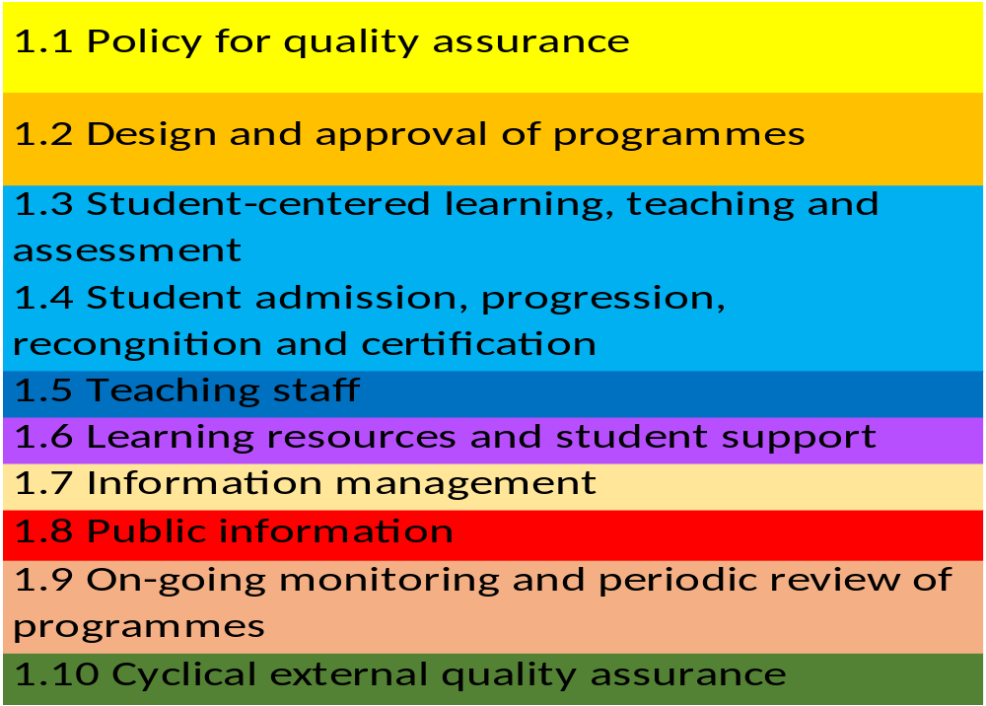
ESG – part I
New ESG, 2015

Slide 11
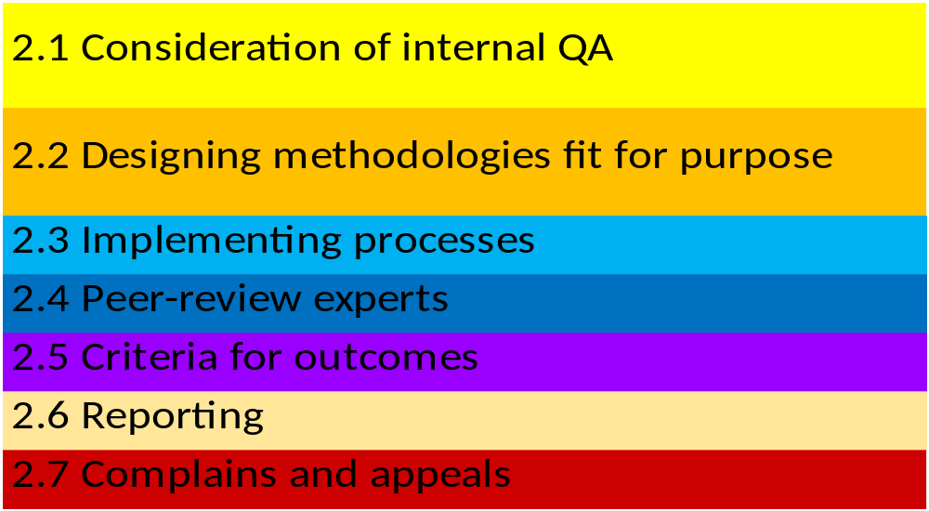
ESG – part II
New ESG

Slide 12
ESG 2.1. Consideration of internal QA
All ESG standards, Part I, are included in ASHE criteria
HEIs have primary responsibility for the quality of their provision and its assurance, authenticity of data
ASHE collects a wealth of information about HEIs under review (self-evaluation report, internal audit report, web, intranet)
HEIs provide information on their quality assurance & IR
Official HEI documentation is used for structured analyses
Accredited HEIs find ways to comply with ESG in national and international perspective, adhering to the European dimension

Slide 13
ESG 2.3. Implementing processes
SELF-ASSESSMENT
SITE VISIT
WRITING
REPORT
FOLLOW -UP

Slide 14
1.1 Policy for quality assurance
Policy-strategic management
Appropriate structures and processes
Coherent institutional quality assurance system
  continuous improvement
  accountability
Development of quality culture
  Responsible and active internal and external stakeholders

Slide 15
EHEA impacts
Evolution of QA (fit for purpouse, more tailor-made, shifting focus to topics such as internationalisation and entrepreneurship)
Findings:
  Trend for HEIs to develop their own strategies for quality enhancement
  Working in line with ESG and national legislation
  Students participation in QA
  Focus on teaching and QA in research

Slide 16

Common practice - RC
Development in strategic planning
All HEIs established internal QA units
Part time employees
98 internal audits (120 HEIs)
Continuous investment in professional development of human resources (QA professionals, leaders….)
Capacity building of auditors (responsibilities)
Students and external steakholders are included in internal QA (motivation)

Slide 17
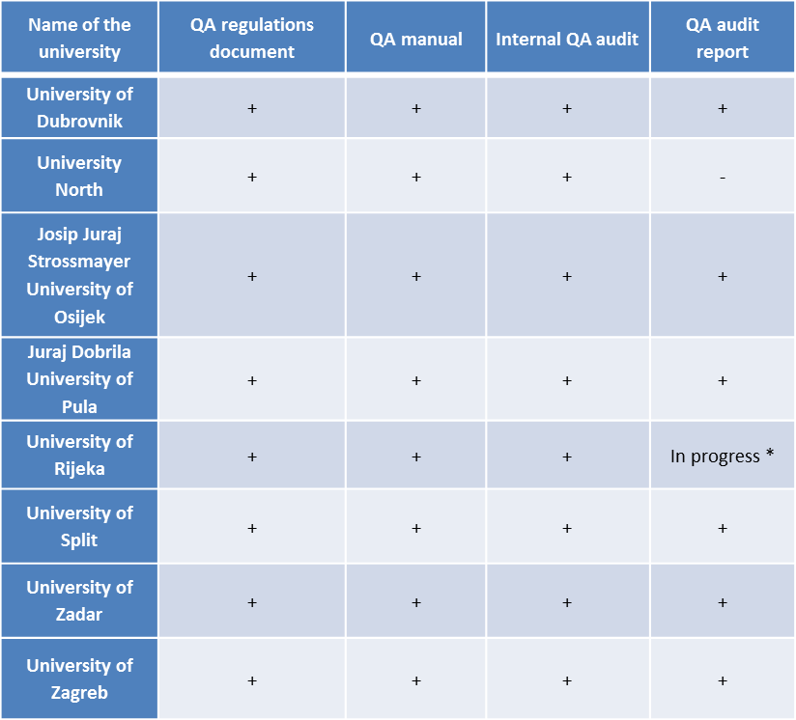
QA indicators at public universities, 2015
* University of Rijeka has a three-year internal audit cycle.

Slide 18
1.2 Design and approval of programmes
Processes for the design and approval of programmes
  Objectives (in line with HEIs strategy) + intended LO
  qualifications → national QF → FQ - EHEA
  are subject to a formal institutional approval process
  designed by involving students and other stakeholders
  benefit from external expertise
  facilitating student progression
  define the expected student workload - ECTS
Notes:
HEIs should have formal processes in place for the
HEIs are encouraged to have stakeholders involved in the development of their programmes and to collect feedback from stakeholders (the educational offer should meet labour market needs).

Slide 19
Impact
Implementing national QF
Progress in implementation LO (redefinition),
ECTS
LO and QF as quality assurance tools
More effort is needed (steering and encouraging)
Diploma Supplement
https://www.azvo.hr/en/preglednik

Slide 20
Type of study programmes
Type of study programmes
Professional study programmes | 240
University study programmes | 1130

Slide 21
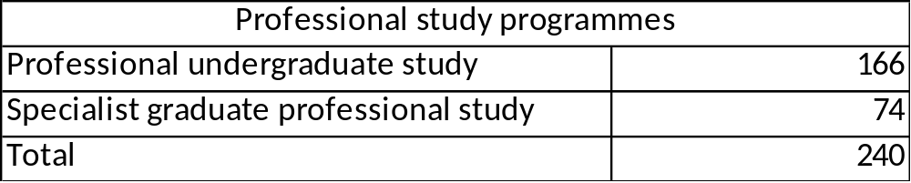
Professional study programmes

Slide 22
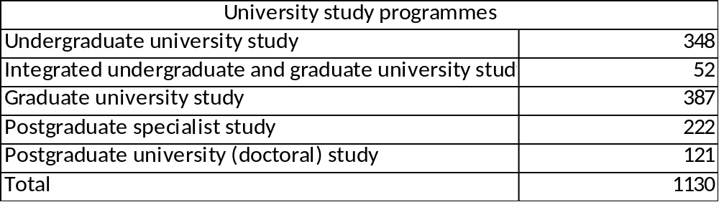
University study programmes

Slide 23
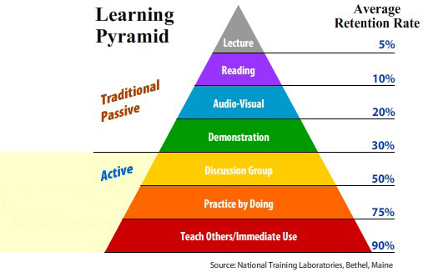
1.3 Student-centred learning, teaching and assessment
Stimulating students’ motivation, self-reflection and engagement in the learning process
  respects the diversity of students and
  their needs, enabling flexible learning paths
  encourages a sense of autonomy in the learner ← teacher’s support
  different modes of delivery
  variety of pedagogical methods
  evaluates and adjusts the modes of delivery and pedagogical methods

Slide 24

1.3 Student-centred learning, teaching and assessment
Assessment criteria and methods, as well as the grading criteria, are published in advance
Assessment is consistent
Feedback to students (advice to learning process)
Appeal procedure
Notes:
an objective and impartial evaluation of student achievements

Slide 25
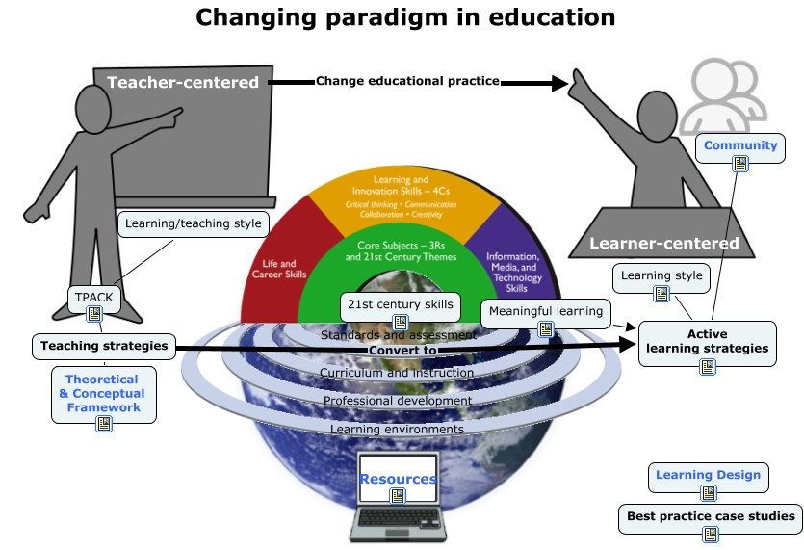
Impact - Modernisation of HE
Shift to student-centred learning
Lack of recognition of the value of student evaluation of teaching, independent learning and the use of LO.
Notes:
Lack of feedback on students feedback & evaluation of teaching and assesment process – the distribution of findingswhat is the impact

Slide 26
1.4 Student admission, progression, recognition and certification
Consistently apply pre-defined and published regulations covering all phases of the student “life cycle”
Admission policies, processes and criteria are implemented consistently and transparently
Processes and tools to collect, monitor and act on information on student progression (ISVU)
Fair recognition of higher education qualifications, periods of study and prior learning, including the recognition of non-formal and informal learning

Slide 27

1.5 Teaching staff
Fair and transparent processes for the recruitment and development of staff
Assure the competences of teachers
Provide a supportive environment
  offer opportunities for and promote the continuous professional development of TS
  encourage innovation in teaching methods and the use of new technologies
Notes:
HEI responsibility extends to providing opportunities for continuous professional career development as a professional teacher and not just as a subject/discipline specific academic;
Teaching as a high-priority contractual obligation,
guidance, counselling and coaching methods;

Slide 28
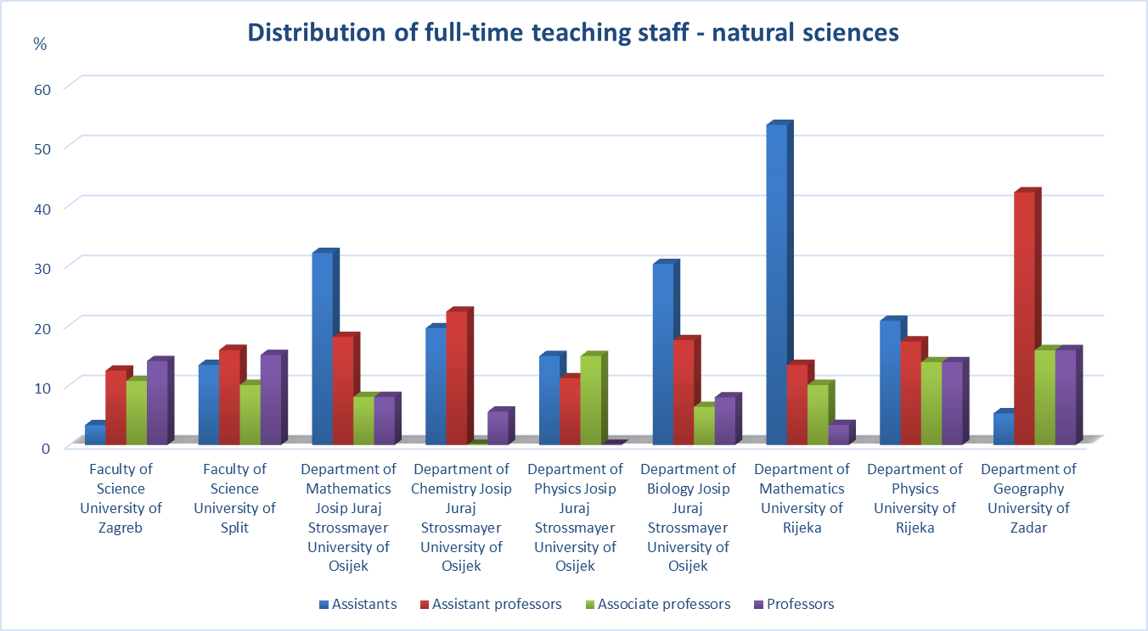

Slide 29
Impact
HEIs are encouraged to strengthen professional and pedagogical training of teachers and the use of innovative teaching methods (e.g. University of Rijeka Centre for Teacher Education, University of Zagreb Centre for Enhancement of Teaching; by 2020, all teachers should undergo certified pedagogical training).
Key responsibility of academic staff to ensure they are qualified and able to teach well
HEIs are encouraged to collect feedback on the quality of teaching (introducing student surveys to monitor the quality of teaching, peer review, self-reflection)
Heads of HEIs – recognise and reward TS (professor emeritus, commendations, centres of excellence in education…)
Notes:
planning, organising and conducting the Supplementary teacher education programme (DPPO); short lifelong learning courses, courses for acquiring teaching competences, as prescribed by the Teaching Module at the University of Rijeka
that it is a key responsibility of institutions to ensure their academic staff are well trained and qualified as professional teachers and not just qualified in a particular academic subject;

Slide 30
1.6 Learning resources and student support
Adequate funding
Range of resources to assist student learning
  physical resources
  human support

Slide 31

1.7 Information management
Collect, analyse and use relevant information for the effective management of their programmes and other activities
  Key performance indicators
  Profile of the student population
  Student progression, success and drop-out rates
  Student satisfaction with study programmes
  Learning resources and student support available
  Career paths of graduates

Slide 32
1.8 Public information
Publish information about their activities & programmes (clear, accurate, objective, up-to date and readily accessible)
  Programmes
  Selection criteria
  Intended LO of study programmes
  Qualifications awarded
  Teaching, learning and assessment procedures used
  Pass rates and learning opportunities available to students, as well as information on graduate employment.

Slide 33
1.9 On-going monitoring and periodic review of programmes
Monitoring and periodical review of programmes - leads to continuous improvement of programmes
  The content of the programme includes the latest research in the given discipline, thus ensuring that the programme is up-to-date
  The changing needs of society
  The students’ workload, progression and completion rates
  The effectiveness of student assessment procedures
  The student expectations, needs and satisfaction in relation to the programme
  The learning environment and support services, and their fitness for purpose for the programme

Slide 34
Impact
The first evaluation cycle in Croatia encouraged the establishment of alumni clubs and the involvement of alumni, students and other stakeholders in the development of study programmes
Tracking the changes
Approx. 20 study programmes shut down

Slide 35

1.10 Cyclical external QA
HEIs should undergo external quality assurance, in line with the ESG, on a cyclical basis.
External QA can verify the effectiveness of institutions’ internal QA
Act as a catalyst for improvement
Offer new perspectives
Requirements of the legislative framework
in which they operate continuous process
Take into consideration the progress from last external QA

Slide 36
Impact
Synthesis of re-accreditations carried out (economic field, technical field, biotechnical field, social sciences and humanities; synthesis for other fields and overall five-year cycle still underway)
https://www.azvo.hr/images/stories/vrednovanja/Sinteza_2010_2011.pdf
https://www.azvo.hr/images/stories/vrednovanja/Sinteza_2011_2012.pdf
https://www.azvo.hr/images/stories/Akreditacija/sinteza_biotehni%C4%8Dko_podru%C4%8Dje_2012_2013.pdf
https://www.azvo.hr/images/stories/Akreditacija/2013-2014/sinteza%20dru%C5%A1tveno%20i%20humanisti%C4%8Dko%20podru%C4%8Dje%20 20 13_2014.pdf
Meta-evaluation of audits carried out
https://www.azvo.hr/hr/vrednovanja/postupci-vrednovanja-u-visokom-obrazovanju/audit-visokih-ucilista/metaevaluacija

Slide 37
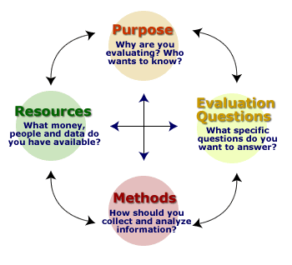
Impact
Synthesis of the first cycle - findings
3 HEIs closed
Approx. 20 programmes shut down
Visibility of Croatian HEA (working together)
Enhancement & challenges
Notes:
20 programa – dislocirani studiji
3 visoka učilišta Visoka škola Višnjan, IGBS, Visoka poslovna škola Minerva - Dugopolje

Slide 38

Thank you
?

